Slide 1
CONTENT
VARIABLES
CONDITIONAL BLOCK (IF,IF-ELSE, SWITCH)
LOOP ( BASIC, WHILE, FOR)
VARRAY

Slide 2
Transaction Properties
Atomicity: Transactions should either completely succeed or completely fail. For any reasons, if the system crashes before the transaction completes, the database state should not change. The data in the database, which was involved with the transaction, should be restored to the previous consistent state. The transaction is indivisible which means it cannot be divided into sub tasks
Consistency: Transactions must preserve database consistency. A transaction transforms the database from one consistent state to another consistent state.
Isolation: A transaction's operations like SELECT, INSERT, UPDATE and DELETE do not interfere with other transactions, or other users of the database. Until a transaction completely succeeds, the database system conceals the individual changes from other transactions.
Durability: Once a transaction completes (commits), the changes made to the database are made permanent and are available to all the transactions that follow it.
These properties are called as ACID (derived from the first letter of the above characteristics) properties.
Notes:
Every transaction system must possess the following characteristics:
Atomicity- Transaction management
DBMS keeps track of the old value of a data on which the transaction acts so that, if there is a failure, the old value of the data is restored as though no transaction acted on it
Consistency-Application programmer
To ensure that the database remains consistent after execution of the transaction
Isolation-Concurrency control
To ensure concurrent execution of transactions results in a state equivalent to that obtained by sequential execution
Durability-Recovery management
To ensure that after successful transaction completion, all updates persist irrespective of system failures
References: Database System Concepts, Henry F Korth, Abraham Silberschatz, Fourth Edition, McGraw-Hill International Edition, Computer Science Series 2002

Slide 3
Integrity
All the data entering into the system must be validated for its correctness and adherence to the organization’s business rules
Data integrity constraints
Required data (NOT NULL constraint)
Domain integrity (CHECK constraint)
Entity integrity (PRIMARY KEY constraint)
Referential integrity (FOREIGN KEY constraint)

Slide 4
Need for PL/SQL
SQL is a flexible, efficient fourth-generation language with features designed to manipulate and examine relational data, but lacks programming capabilities
PL/SQL is a procedural language which helps us to implement procedural logic on an Oracle database
PL/SQL is an extension to SQL developed by Oracle
Oracle can be hosted on many platforms such as Windows, UNIX and PL/SQL technology remains the same in all the platforms paving way for a kind of platform independence
Notes:
PL/SQL paves way for programming with SQL by allowing us to loop through records, manipulating them one row at a time

Slide 5
Implementing transaction with PL/SQL
PL/SQL block structure allows us to group a set of DML statements that does a logical unit of work
Changes made by these series of DML statements can be committed (permanently saved) to the database or rolled back (undone) immediately
If the program fails in the middle of the transaction due to some reasons such as system crash or memory crash, then the database is automatically restored to its earlier state

Slide 6
PL/SQL Architecture
PL/SQL Engine
PL/SQL
Block
Procedural
Procedural
statement
executor
PL /SQL
Block
SQL
Oracle Server
SQL statement executor
Notes:
PL/SQL Environment
PL/SQL is not an Oracle product of its own. It is a technology inbuilt within the Oracle server and by certain Oracle tools. Blocks of PL/SQL are passed to and processed by a PL/SQL engine, which may reside within the tool or within the Oracle server. The engine that is used depends on where the PL/SQL block is being invoked from.
When you submit PL/SQL blocks from a Oracle pre-compiler such as SQL*PLUS, or iSQL*Plus, the PL/SQL engine in the Oracle Server processes them. It separates the SQL statements and sends them individually to the SQL statements executor.
A single transfer is required to send the block from the application to the Oracle Server, thus improving performance, especially in a client-server network. PL/SQL code can also be stored in the Oracle Server as subprograms that can be referenced by any number of applications connected to the database.
References: http://download.oracle.com/docs/cd/B19306_01/appdev.102/b14261/overview.htm#i4603 for the architecture diagram
PL/SQL Environment
PL/SQL is not an Oracle product in its own right; it is a technology used by the Oracle server and by certain Oracle tools. Blocks of PL/SQL are passed to and processed by a PL/SQL engine, which may reside within the tool or within the Oracle server. The engine that is used depends on where the PL/SQL block is being invoked from.
When you submit PL/SQL blocks from a Oracle precompiler such as Pro*C or Pro*Cobol program, user-exit, iSQL*Plus, or Server Manager, the PL/SQL engine in the Oracle Server processes them. It separates the SQL statements and sends them individually to the SQL statements executor.
A single transfer is required to send the block from the application to the Oracle Server, thus improving performance, especially in a client-server network. PL/SQL code can also be stored in the Oracle Server as subprograms that can be referenced by any number of applications connected to the database.

Slide 7
PL/SQL Block structure
[DECLARE]¹
BEGIN
[EXCEPTION] ¹
END;
[ ] ¹ – optional keywords are marked by square brackets
BEGIN & END keywords are mandatory
Notes:
DECLARE and EXCEPTION Keywords are optional. BEGIN and END keywords are mandatory.

Slide 8
Comments in PL/SQL block
Two hyphens(--) placed in the beginning of any statement would be considered as comment
Multi-line comments (C style) are also allowed which begins with /* and ends with */
Nesting of comments are not allowed, similar to C language syntax
DECLARE
--declaration of variables
BEGIN
/* SQL and
PL/SQL statement(s) */
END;

Slide 9
Anonymous PL/SQL blocks (1 of 4)
Do not have any name
Not permanently stored in the database
Cannot call other anonymous PL/SQL blocks as well as itself
Has three sections
Declarative section
Executable section
Exception section
Notes:
Anonymous PL/SQL blocks are not stored permanently in the oracle database. There are other forms of PL/SQL blocks that are stored permanently in the oracle database such as PROCEDURES, FUNCTIONS. These are also called as NAMED PL/SQL blocks.
Every anonymous PL/SQL block has a declaration section, executable section, exception section
The set of all statements that falls between the DECLARE and BEGIN keyword constitutes the declaration section. All PL/SQL variables would be declared in the declaration section.
The set of all statements that falls between the BEGIN and EXCEPTION keyword constitutes the executable section. Any valid SQL and PL/SQL statements can be present in the executable section.
Statements written between the EXCEPTION and END keyword forms the exception section. All runtime errors can be handled with the help of this section.

Slide 10
Anonymous PL/SQL blocks (2 of 4)
Declaration section
An optional section
Used to declare all variables along with their data types
Can also initialize variables
Variables declared in this section can be referred in the executable and exception section
DECLARE
--variable to record the current system date and time
v_datetime TIMESTAMP;
BEGIN
…..
END;
Notes:
All the datatypes available in SQL are supported in PL/SQL too.
For example, to declare a variable to store the current system date and time details, we need declare as shown below in the declaration section
v_datetime TIMESTAMP;
Any number of variables can be declared in the declaration section. There is no upper limit on the number of variables that can be declared within the PL/SQL declaration section.
Two variables cannot be declared on the same. For example, v_customername, v_suppliername VARCHAR2(30);--INVALID.
Variables declared can also be initialized with some initial values. If a variable is not initialized, the default value present in the variable would be NULL.
Variables declared can be referred in the executable section and exception section.

Slide 11
Anonymous PL/SQL blocks (3 of 4)
Executable section
A mandatory section
Used to write SQL and PL/SQL statements
Must contain some executable statements or NULL, which is a valid executable statement
The above PL/SQL block is valid, which does nothing
- BEGIN
END;
The above PL/SQL block is invalid and would throw an error, since no executable statement is present in between BEGIN and END
BEGIN
NULL;
END;

Slide 12
Anonymous PL/SQL blocks (4 of 4)
Exception section
An optional section
Used to trap errors generated during program execution
Notes:
Exception section is another optional section in an anonymous PL/SQL block for handling runtime errors. This section is especially used to trap the runtime errors, define an alternative routine, or define a recovery mechanism which need to be executed during runtime errors. Example: division by zero

Slide 13
PL/SQL block execution
How the PL/SQL block of code can be executed?
An anonymous block of code can be executed either from a file or by typing the code at the SQL> prompt
To run the block of code Helloworld.sql type the following in SQL prompt
SQL> @Helloworld.sql
Notes:
One of the way of execution is,
Type the entire code in a notepad file and save it with an extension .sql
In the SQL prompt say @ followed by the complete path of the .sql file Example: SQL>@”C:\Helloword.sql”
Another way of execution is, type the PL/SQL code directly in the SQL prompt and give / (forward slash) at the end for execution. Give dot (.) to stop generating line numbers.
SQL>SET SERVEROUTPUT ON
SQL> BEGIN
2 DBMS_OUTPUT.PUT_LINE('First PL/SQL code');
3 END;
4 .
SQL> /
First PL/SQL code
PL/SQL procedure successfully completed.

Slide 14
Named PL/SQL blocks (1 of 2)
PL/SQL blocks can have a name
Named blocks have an additional section called HEADER
HEADER conveys the name of the block and whether the block is a PROCEDURE or a FUNCTION
If the named PL/SQL block is a FUNCTION then we have to specify the data type of value it would be returning
When the block is run, it does not execute immediately, rather it compiles and stores it in the database for later execution

Slide 15
Named PL/SQL blocks (2 of 2)
Other procedures and functions can be invoked within a named PL/SQL block
Parameters can be passed to and returned from a named PL/SQL block
CREATE [ OR REPLACE ] PROCEDURE block_name(p_param DATATYPE)
IS/AS
--declaration of variables
BEGIN
--SQL and PL/SQL statements
EXCEPTION
--error handling
END;
Notes:
More on these will be dealt in streams

Slide 16
Variables & Data types (1 of 7)
Variables
Variables are memory regions used to hold data
Type of value stored is decided by the data type
Declared in the DECLARE section
Scalar datatype
A scalar datatype can hold a single value
Subcategories
Character/String
Number
Boolean
Date/Time

Slide 17
Variables & Data types (2 of 7)
Syntax
Variable name followed by CONSTANT keyword before specifying the datatype would be treated as constants. Constants must be initialized.
Variables defined as NOT NULL also have to be initialized
Using assignment operator (:=) or DEFAULT keyword we can assign initial values to variables and constants
Variables which are uninitialized would be having NULL values by default, irrespective of the datatype of that variable
variable_name [CONSTANT] datatype [ NOT NULL ] [ := value ]

Slide 18
Variables & Data types(3 of 7)
Character/String
CHAR(n) – Fixed length character datatype. The precision is specified in integer which represents the number of bytes
CHAR(n CHAR) – Stores n characters regardless of the number of bytes occupied per character. Useful with multibyte characters such as Chinese alphabets
VARCHAR2(n) – Variable length character datatype which can store upto 32,767 bytes(32K)
VARCHAR2(n CHAR) – Stores n characters regardless of the number of bytes occupied per character. Useful with multibyte characters
Notes:
Traditionally database columns which hold alphanumeric data have been defined using the number of bytes they store. This approach was fine as the number of bytes equated to the number of characters when using single-byte character sets. With the increasing use of multibyte character sets to support globalized databases comes the problem of bytes no longer equating to characters.
For example,
DECLARE
v_customername VARCHAR2(20);
By default, this declaration means that the variable v_customername can store up to 20 bytes.
Using character semantics, we modify the above declaration.
DECLARE
v_customername VARCHAR2(20 CHAR);
The addition of CHAR to precision means that the string v_customername variable will now store up 20 characters, regardless of the number of bytes per character.

Slide 19
Variables & Data types(4 of 7)
Examples on Character/String
SQL> DECLARE
2 v_productcategory VARCHAR2(20) :='Mobilephone';
3 v_vendorname CHAR(20) NOT NULL:= 'Joe';
4 v_customername VARCHAR2(20 CHAR) DEFAULT 'John';
5 c_productname CONSTANT CHAR(20 CHAR) := 'NOKIA';
…..

Slide 20
Variables & Data types(5 of 7)
Number
PLS_INTEGER –used when a whole number is used in arithmetic operations but not stored in the database
NUMBER (p , s) – used for storing integer and floating-point values
p- total number of digits allowed for the value
s- number of digits to the right of the decimal place
SQL> DECLARE
2 v_itemqty PLS_INTEGER;
3 v_itemprice NUMBER(7,2);
Decimal point is ignored for width
P=7
7 – 2 = 5
.
S=2
Notes:
PLS_INTEGER - variables declared as PLS_INTEGER can be assigned values between -2**31 .. 2**31, ( -2,147,483,647 to 2,147,483,647)
PLS_INTEGER operations use machine arithmetic, so they are generally faster than NUMBER and INTEGER operations
The NUMBER datatype stores numbers with a precision of p digits and a scale of s digits. The precision and scale are optional. Numeric datatypes are used to store negative, positive integers, fixed-point numbers and floating-point numbers. The precision can be between 1 and 38 and scale has a range between -84 and 127. If the precision and scale are omitted, oracle assumes the maximum of the range for both values.

Slide 21
Variables & Data types(6 of 7)
Boolean
Used for storing boolean value such as TRUE, FALSE, and NULL
Do not attempt to print or display the value stored in boolean variable, as it is not possible
SQL> DECLARE
2 v_test BOOLEAN;
3 BEGIN
4 v_test:='TRUE'; --Wrong
5 v_test:= TRUE; --Correct
6 END;
Notes:
When assigning values to boolean variables, do not enclose in quotes
When declared without initialization, the default value would be NULL

Slide 22
Variables & Data types(7 of 7)
Date
Used for storing DATE
Stores the century, year, month, day, hour, minute, second
Timestamp
Used for storing the date and time
Provides sub second time upto nine digits(the default is six)
SQL> DECLARE
2 v_transactiondate DATE:= SYSDATE;
3 v_billingdate TIMESTAMP := SYSTIMESTAMP;
. . .
. . .
Notes:
The DATE datatype stores the century, year, month, day, hour, minute and second. Fractional seconds are not available in the date datatype.
The TIMESTAMP datatype stores the date/time details much like DATE datatype, and in addition it also provides the subsecond details upto nine digits ( the default is six)
SQL> DECLARE
2 v_billingdate TIMESTAMP(9):= SYSTIMESTAMP;
3 BEGIN
4 DBMS_OUTPUT.PUT_LINE(v_billingdate);
5 END;
6 /
08-JUN-09 12.07.07.902000000 PM
PL/SQL procedure successfully completed.

Slide 23
DBMS_OUTPUT.PUT_LINE (1 of 2)
DBMS_OUTPUT.PUT_LINE
An oracle supplied packaged procedure
DBMS_OUTPUT is a package and PUT_LINE is a procedure within the package
The string which has to be printed should be specified in parenthesis, following the PUT_LINE keyword
Using SET SERVEROUTPUT ON this package should be enabled in SQLPLUS

Slide 24
DBMS_OUTPUT.PUT_LINE (2 of 2)
SQL> SET SERVEROUTPUT ON
SQL> DECLARE
2 v_productcategory VARCHAR2(20) :='Mobile Phone';
3 v_itemqty PLS_INTEGER := 1000;
4 v_itemprice NUMBER(7,2) DEFAULT 60.50;
5 v_transactiondate DATE:= SYSDATE;
6 v_billingdate TIMESTAMP := SYSTIMESTAMP;
7 v_test BOOLEAN:=TRUE;
8 BEGIN
9 DBMS_OUTPUT.PUT_LINE(v_productcategory);
10 DBMS_OUTPUT.PUT_LINE(v_transactiondate);
11 DBMS_OUTPUT.PUT_LINE (v_billingdate);
12 END;
13 /
Mobile Phone
10-MAR-09
10-MAR-09 03.39.27.845000 PM

Slide 25
More about DBMS_OUTPUT package
Used to display messages to the screen from an anonymous PL/SQL block
Debugging is the most popular use of this package
When executing a PL/SQL block, any DBMS_OUTPUT lines are placed in an output buffer, which displays its contents on the screen when the program has completed execution
Procedures available | Description
DBMS_OUTPUT.ENABLE | Allows message display (not necessary if you have SERVEROUTPUT set to ON in SQL*PLUS)
DBMS_OUTPUT.DISABLE | Does not allow message display
DBMS_OUTPUT.PUT | Places information in the buffer
DBMS_OUTPUT.PUT_LINE | Places information in the buffer followed by an end-of-line marker
DBMS_OUTPUT.NEW_LINE | Places an end-of-line marker in the buffer

Slide 26
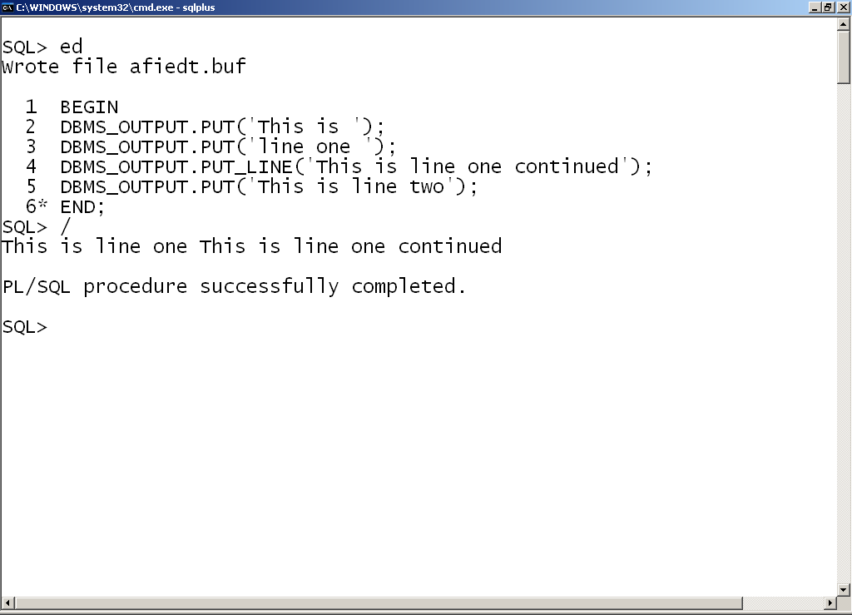
DBMS_OUTPUT procedures usage
1. PUT procedure places information in the buffer
2. PUT_LINE procedure displays all the data placed in the buffer so far
4. Output displayed on a single line
3. PUT places this value in the buffer. It is not displayed

Slide 27
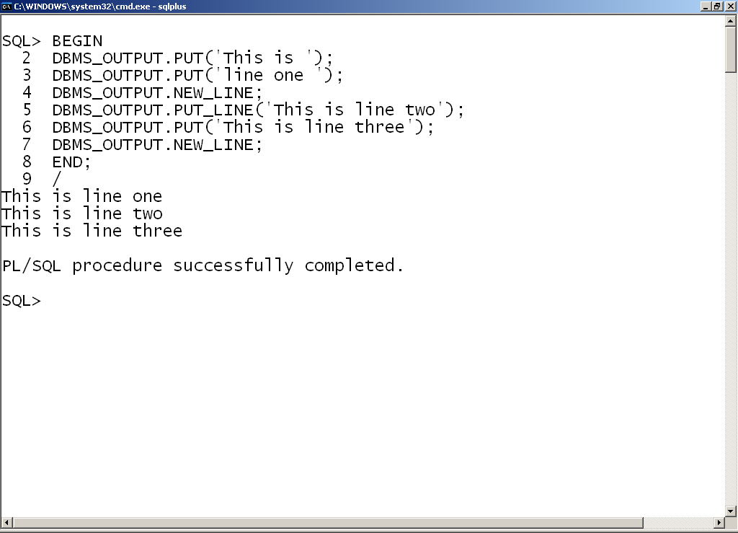
DBMS_OUTPUT procedure usage
1. NEW_LINE forces the display of buffer contents and moves to a new line for display
2. Output now shown on multiple lines

Slide 28
Anchored declarations %TYPE (1 of 2)
Usage 1 : Declare variables that directly maps to a column definition in the database
SQL> DECLARE
1 -- variablename TABLENAME.COLUMNNAME%TYPE; --Syntax
2 v_itemcode ITEM.ITEMCODE%TYPE;
. . . .
. . . .
Notes:
Here ITEM is a database table name, ITEMCODE is a column in ITEM table. If ITEM.ITEMCODE is VARCHAR2(6), then the same datatype would be applied to v_itemcode
Change of column precision or datatype of ITEMCODE in the database, would in turn change v_itemcode automatically as the variable is anchored

Slide 29
Anchored declarations %TYPE (2 of 2)
Convenient way of associating PL/SQL variable with database column definitions
NOT NULL constraint or CHECK constraint associated with table column would not be applicable to PL/SQL variable
Usage 2: is to declare variables that directly maps to a datatype of previously declared variable
SQL> DECLARE
2 v_quantityonhand NUMBER(7) NOT NULL:= 500;
3 v_reorderqty v_quantityonhand%TYPE :=50;
. . . .
. . . .
Notes:
The datatype of v_quantityonhand and NOT NULL constraint is applied to v_reorderqty. Value of v_quantityonhand would not be copied to v_reorderqty

Slide 30
Bind variables
Declared in the host environment such as SQL*PLUS
Used to pass runtime values out of one or more PL/SQL programs to the host environment
PRINT command helps us in displaying the value of one bind variable
Would be alive only in the current session
SQL> SET SERVEROUTPUT ON
SQL> VARIABLE g_itemid varchar2(20);
SQL> BEGIN
2 :g_itemid :='STN001';
3 END;
4 /
PL/SQL procedure successfully completed.
SQL> PRINT g_itemid
G_ITEMID
----------------
STN001

Slide 31
Substitution variables
Declared in the host environment such as SQL*PLUS
Used to pass runtime values into one or more PL/SQL programs
You will not be prompted to enter value during execution of the block
Would be alive only in the current session
SQL> SET SERVEROUTPUT ON
SQL> DEFINE g_itemid = 'PEN';
SQL> DECLARE
2 v_itemname VARCHAR2(30);
3 BEGIN
4 v_itemname :='&g_itemid';
5 DBMS_OUTPUT.PUT_LINE(v_itemname);
6 END;
7 /
PEN
PL/SQL procedure successfully completed.

Slide 32
Accepting input in PL/SQL
Declare the variables in the declaration section of PL/SQL block
Accept the value for variables in the executable block
Display the accepted values as shown below
SQL> SET SERVEROUTPUT ON
SQL> DECLARE
2 v_itemname VARCHAR2(30);
3 BEGIN
4 v_itemname :='&v_item';
5 DBMS_OUTPUT.PUT_LINE(v_itemname);
6 END;
7 /
Enter value for v_item: STN001
old 4: v_itemname :='&v_item';
new 4: v_itemname :='STN001';
STN001
PL/SQL procedure successfully completed.
Notes:
PL/SQL is not interactive. Please follow the code snippet to understand the same.
SQL> DECLARE
2 v_customername VARCHAR2(20);
3 v_qtyrequired NUMBER;
4 BEGIN
5 v_customername := '&v_customername';
6 DBMS_OUTPUT.PUT_LINE('Customer Name : '||v_customername);
7 v_qtyrequired := &v_qtyrequired;
8 DBMS_OUTPUT.PUT_LINE('Required Qty : '||v_qtyrequired);
9 END;
10 /
Enter value for v_customername: JAMES
old 5: v_customername := '&v_customername';
new 5: v_customername := 'JAMES';
Enter value for v_qtyrequired: 20
old 7: v_qtyrequired := &v_qtyrequired;
new 7: v_qtyrequired := 20;
Customer Name : JAMES
Required Qty : 20
PL/SQL procedure successfully completed.
While executing the above PL/SQL block, the system would ask us to enter the customer name and quantity required both, only after which it will display the entered customer name and quantity required details. Even though there is a presence of DBMS_OUTPUT.PUT_LINE statement immediately after accepting the customer name, the system would not do so. Please be aware of this behavior.

Slide 33
SET VERIFY ON/OFF
Prints two lines for every substitution performed within a PL/SQL block
ON – Displays the substitution performed (Default)
OFF – Suppress the display of substitution performed
SQL> SET VERIFY OFF
SQL> SET SERVEROUTPUT ON
SQL> DECLARE
2 v_itemname VARCHAR2(30);
3 BEGIN
4 v_itemname :='&v_item';
5 DBMS_OUTPUT.PUT_LINE(v_itemname);
6 END;
7 /
Enter value for v_item: STN001
STN001
PL/SQL procedure successfully completed.

Slide 34
Operators & Expressions
Concatenation Operator ( || )
Arithmetic Operators( +, -, *, /,**)
Relational Operators( =, !=, <, >, <=, >=)
Logical Operators (AND, OR and NOT)

Slide 35
Concatenation Operator
|| is the concatenation operator
Concatenates two or more strings together
Do not use ‘||’ instead of Logical operator ‘OR’
DECLARE
v_customername varchar2(10):=‘John';
BEGIN
v_customername := v_customername || '10';
DBMS_OUTPUT.PUT_LINE('value of v_customername : '|| v_customername);
END;
value of v_customername : John10
Notes:
This operator attaches two or more strings (or arguments which can be converted implicitly to a string) together.

Slide 36
Arithmetic Operator - Addition
Addition of NULL with any number is NULL
Only numeric and date data types can be used along with arithmetic operators
DECLARE
v_reorderlevel NUMBER;
BEGIN
v_reorderlevel := v_reorderlevel+10; -- NULL +10
DBMS_OUTPUT.PUT_LINE(‘value of v_reorderlevel : '|| v_reorderlevel);
END;
Value of v_reorderlevel : (NULL)

Slide 37
Arithmetic Operator - Exponentiation
** is the exponential operator
DECLARE
v_number NUMBER:=2;
BEGIN
v_number:=v_number **2;
DBMS_OUTPUT.PUT_LINE( 'value of v_number : '|| v_number);
END;
value of v_number : 4

Slide 38
Arithmetic operator – With Date
Arithmetic operators can be used with date
SET SERVEROUTPUT ON
DECLARE
v_today DATE := '31-MAR-2009';
v_tomorrow DATE;
BEGIN
v_tomorrow := v_today + 1;
DBMS_OUTPUT.PUT_LINE('Tomorrow''s date is '||v_tomorrow);
END;
Tomorrow's date is 01-APR-09

Slide 39
Nested PL/SQL blocks (1 of 4)
A PL/SQL block defined within another PL/SQL block is called nested PL/SQL block
Can be nested in the executable section or in exception handling section
One or more nested blocks can be present within an anonymous PL/SQL block
Overlapping of nested blocks are not allowed
Notes:
We can define a PL/SQL block within another PL/SQL block. Thus the block defined inside is called a nested PL/SQL block. Nested PL/SQL block can also have declaration section, executable section, exception section. One or more PL/SQL blocks can be present within an anonymous PL/SQL block
Nested PL/SQL blocks can be present in the executable section or in the exception handling section. While defining nested blocks, make sure that there are no crossovers. Meaning before you complete defining one block, do not start the definition of another block.
DECLARE
BEGIN
EXCEPTION
DECLARE
END;
BEGIN
EXCEPTION
END;

Slide 40
Nested PL/SQL blocks (2 of 4)
DECLARE
--declaration of variables in the enclosed block
BEGIN
--SQL and PL/SQL statement(s)
DECLARE
--- declaration of variables in the nested block
BEGIN
-- SQL & PL/SQL statement(s) in nested block
END;
DECLARE
-- declaration of variables in the nested block
BEGIN
-- SQL & PL/SQL statement(s) in nested block
END;
--SQL and PL/SQL statement(s)
END;

Slide 41
Nested PL/SQL blocks (3 of 4)
DECLARE
--declaration of variables in the enclosed block
BEGIN
--SQL and PL/SQL statement(s)
DECLARE
-- declaration of variables in the nested block
BEGIN
-- SQL & PL/SQL statement(s) in nested block
DECLARE
-- declaration of variables
BEGIN
-- SQL and PL/SQL statement(s)
END;
END;
--SQL and PL/SQL statement(s)
END;

Slide 42
Nested PL/SQL blocks (4 of 4)
DECLARE
--declaration of variables in the enclosed block
BEGIN
--SQL and PL/SQL statement(s)
DECLARE
-- declaration of variables in the nested block
BEGIN
-- SQL & PL/SQL statement(s) in nested block
DECLARE
-- declaration of variables
END;
BEGIN
-- SQL and PL/SQL statement(s)
END;
--SQL and PL/SQL statement(s)
END;
Notes:
Overlapping of PL/SQL blocks are not allowed. The above slide is an example of the same.

Slide 43
Scope of variables(1 of 3)
Variables declared in the DECLARE section would be visible in the EXECUTABLE section and EXCEPTION section
Lifetime of variables declared in the nested block will be only within the nested block
Variables declared in the outermost block are visible in all the nested blocks

Slide 44
Scope of variables (2 of 3)
DECLARE
v_qoh NUMBER:=10;
BEGIN
DBMS_OUTPUT.PUT_LINE('The value of v_qoh: '||v_qoh);
DBMS_OUTPUT.PUT_LINE('The value of v_price: '||v_price);
END;
ERROR because scope of the variable is within the inner DECLARE to its END.
identifier 'V_PRICE' must be declared
Scope of the variable is from DECLARE to its END
DECLARE
v_price NUMBER:=20;
BEGIN
DBMS_OUTPUT.PUT_LINE('The value of v_qoh: '||v_qoh);
DBMS_OUTPUT.PUT_LINE('The value of v_price: '||v_price);
END;

Slide 45
Scope of variables(3 of 3)
DECLARE
v_itemid NUMBER(4) := 1001;
BEGIN
DECLARE
v_itemid NUMBER(4) := 1002;
BEGIN
DBMS_OUTPUT.PUT_LINE( v_itemid);
END;
DECLARE
v_quantityonhand NUMBER(4):=300;
BEGIN
DBMS_OUTPUT.PUT_LINE( v_itemid);
END;
DBMS_OUTPUT.PUT_LINE(v_itemid);
END;
Output
1002
1001
1001
Notes:
v_itemid with value 1001 declared in the outermost block is visible in both the nested blocks
But another v_itemid with value 1002 is declared in the first nested block with similar name as that of outer block
As local variable takes higher precedence within any block only v_itemid with value 1002 would be visible in the first nested block

Slide 46
Qualifying Identifiers
If the variable name is same then we can refer each variable with the help of the labels
Anonymous PL/SQL blocks can be qualified with identifiers (or names). While qualifying use << and >> angle brackets to enclose the identifiers.
<<supplier>>
DECLARE
v_price Number:=10;
BEGIN
<<shopkeeper>>
DECLARE
v_price Number:=20;
BEGIN
DBMS_OUTPUT.PUT_LINE(‘Supplier Price: '||supplier.v_price);
DBMS_OUTPUT.PUT_LINE(‘Shopkeeper Price: '||shopkeeper.v_price);
END;
DBMS_OUTPUT.PUT_LINE(‘Supplier Price: '||supplier.v_price);
DBMS_OUTPUT.PUT_LINE(‘Shopkeeper Price: '||shopkeeper.v_price);
END;
ERROR: label 'SHOPKEEPER' reference is out of scope
Notes:
For example, in the above slide, <<supplier>> is one PL/SQL block within which there is another <<shopkeeper>> PL/SQL block. These qualifying identifiers will be useful if there is a presence of one or more variables with the same name.
V_price is a variable declared within the supplier block. Similar variable with the same name exist in the shopkeeper block also. The scope or lifetime of variables would be within the PL/SQL block in which it is declared.
If you simply mention a variable without any qualifier, it will refer to the variable declared in the current block.
For ex. If you say DBMS_OUTPUT.PUT_LINE(‘Supplier Price: '||v_price); it refers to the variable declared in the supplier block
If the variable is not declared in the current block in which it is referred or invoked, PL/SQL compiler will look for the presence of the variable in the enclosing block.
For ex. If you say DBMS_OUTPUT.PUT_LINE(‘Supplied Qty: '||v_Qty); in the shopkeeper block PL/SQL compiler will check whether this v_Qty is declared in shopkeeper. If not, it will check supplier block for the declaration. If declared in supplier block execution would proceed else it would throw an error message
Accessing shopkeeper block v_price in supplier block scope is illegal. As the v_price variable is out of scope of shopkeeper, it would not be visible

Slide 47
IF-THEN
IF condition
THEN
action;
END IF;
DECLARE
v_qoh NUMBER :=10;
v_itemrequired NUMBER :=&b_itemrequired;
BEGIN
IF v_itemrequired>v_qoh THEN
DBMS_OUTPUT.PUT_LINE('Item not available ');
END IF;
END;
Enter value for b_itemrequired: 11
old 3: v_itemrequired NUMBER :=&b_itemrequired;
new 3: v_itemrequired NUMBER :=11;
Item not available
Notes:
Condition can be any expression,variable,constant, or identifier compared to any other expression, variable, constant, or identifier.
The condition must evaluate to TRUE, FALSE or NULL

Slide 48
IF-THEN-ELSE
IF condition
THEN
action;
ELSE
action;
END IF;
DECLARE --Comparing NUMBER datatypes
v_qoh NUMBER :=10;
v_itemrequired NUMBER :=&b_itemrequired;
BEGIN
IF v_itemrequired > v_qoh THEN
DBMS_OUTPUT.PUT_LINE('Item not available ');
ELSE
DBMS_OUTPUT.PUT_LINE('Item available ');
END IF;
END;
Enter value for b_itemrequired: 9
old 3: v_itemrequired NUMBER :=&b_itemrequired;
new 3: v_itemrequired NUMBER :=9;
Item available
Notes:
Condition can be any expression,variable,constant, or identifier compared to any other expression, variable, constant, or identifier.
The condition must evaluate to TRUE, FALSE or NULL

Slide 49
IF-THEN-ELSE
Inequality of 2 given numbers or dissimilarity of strings can be checked with either != or <>
SET SERVEROUTPUT ON
DECLARE --Comparing VARCHAR2 datatypes
v_string1 VARCHAR2(10) := 'hello';
v_string2 VARCHAR2(10) := 'hello';
BEGIN
IF v_string1 <> v_string2 THEN
DBMS_OUTPUT.PUT_LINE('Both are unequal');
ELSE
DBMS_OUTPUT.PUT_LINE('Both are equal');
END IF;
END;
Both are equal

Slide 50
IF-THEN-ELSIF
IF condition
THEN
action;
ELSIF condition
THEN
action;
[ELSE
action;]
END IF;
DECLARE
v_qoh NUMBER :=10;
v_itemrequired NUMBER :=&b_itemrequired;
BEGIN
IF v_itemrequired>v_qoh THEN
DBMS_OUTPUT.PUT_LINE('Item not available ');
ELSIF v_itemrequired=10 THEN
DBMS_OUTPUT.PUT_LINE('Item available but no more stock ');
ELSE
DBMS_OUTPUT.PUT_LINE('Item not available’);
END IF;
END;
Notes:
For every IF condition there must be END IF.
If we are using ELSE IF condtion….. Then for every IF we are using we have to use END IF.
The advantage of using ELSIF is, we can close all the IF s with one END IF .
Please note the spelling of ELSIF.

Slide 51
1. LOOP
This is an infinite LOOP!!!
LOOP
action
END LOOP;
BEGIN
LOOP
DBMS_OUTPUT.PUT_LINE('I AM IN LOOP!!!');
END LOOP;
END;
There must be an EXIT condition to EXIT from the LOOP
DECLARE
v_price NUMBER:=1;
BEGIN
LOOP
DBMS_OUTPUT.PUT_LINE('Price: '||v_price);
v_price:=v_price+1;
EXIT WHEN v_price >5;
END LOOP;
END;
OUTPUT:
---------
Price: 1
Price: 2
Price: 3
Price: 4
Price: 5
Notes:
An exit statement or an exit when statement is required to break the loop

Slide 52
2. Numeric FOR Loop
FOR counter IN low_number .. high_number
LOOP
action;
END LOOP;
The variable is automatically declared and initialized
BEGIN
FOR v_price IN 1..5
LOOP
DBMS_OUTPUT.PUT_LINE('Price: '||v_price);
END LOOP;
END;
OUTPUT:
---------
Price: 1
Price: 2
Price: 3
Price: 4
Price: 5
Notes:
What happens if we declare and initialize the same variable?

Slide 53
2b. Numeric FOR Loop REVERSE
FOR counter IN REVERSE low_number .. high_number
LOOP
action;
END LOOP;
The variable is automatically declared and initialized
BEGIN
FOR v_price IN REVERSE 1..5
LOOP
DBMS_OUTPUT.PUT_LINE('Price: '||v_price);
END LOOP;
END;
OUTPUT:
---------
Price: 5
Price: 4
Price: 3
Price: 2
Price: 1
Notes:
What happens if we declare and initialize the same variable, which was used in the FOR loop?

Slide 54
3. WHILE Loop
WHILE condition
LOOP
action;
END LOOP;
DECLARE
v_price NUMBER:=1;
BEGIN
WHILE v_price <=5
LOOP
DBMS_OUTPUT.PUT_LINE('Price: '||v_price);
v_price:=v_price+1;
END LOOP;
END;
OUTPUT:
---------
Price: 1
Price: 2
Price: 3
Price: 4
Price: 5

Slide 55
Arrays
VARRAY is a data structure which can store a fixed-sized sequential collection of element of the same type.
N is the number of elements (maximum) in the varray
Element_type is the datatype of the element of the array
CREATE OR REPLACE TYPE varray_type_name IS
VARRAY(n) of <element_type>
Notes:
TYPE varray_type_name is varray(n) of varchar2(10);

Slide 56
Coding Standards
In PL/SQL
v_variable for variables
Example: v_itemname, v_productname, v_employeeno
c_constant for constants
Example: c_discount
e_Exception for user-defined exceptions (Discussed later)
Example: e_Invalid_ItemId, e_Invalid_EmpId
Notes:
Reference for coding standards: Oracle Database 10g PL/SQL programming by Scott Urman, Ron Hardman, Michael McLaughlin Tata McGraw Hill Publishing

Slide 57
Coding Standards
In PL/SQL
cur_cursorname for cursor variable (Discussed later)
Example: cur_branch, cur_emp
All table names and column names in lower case
Example: emp, employeename
All Keywords should be in UPPER case
Example: SELECT, FROM, WHERE, GROUP BY, ORDER BY
Usage: SELECT ename FROM emp WHERE empno=v_empno;

